Slide 1
Oregon Roadmap

Slide 2
Oregon Roadmap design
Based off of the popular edutainment game ‘Oregon Trail’
Designed to simulate the agile process, including sprints, story points, scrum teams, etc
You start by hiring a team of staff to work on a product
Events occur and you have to accumulate and spend story points to complete tasks, whilst keeping morale high
At the end of the game, you are scored based on number of tasks completed and overall team morale
If your score is too low, you go bankrupt

Slide 3
React.js
React is a JavaScript library for creating user interfaces by Facebook and Instagram
Used to solve issues that come with updating the UI for large applications with data that is constantly changing
This is basically the exact opposite of the small, state-based game we decided to make

Slide 4
It was a bloody nightmare

Slide 5
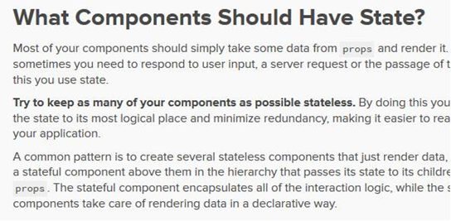
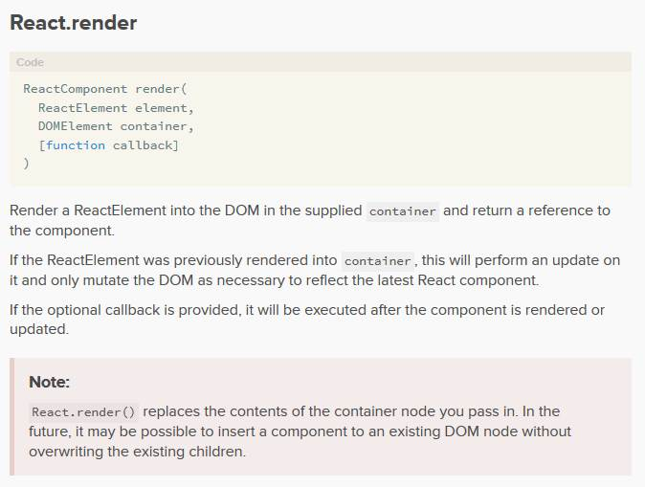
Here’s why

Slide 6
Example events

Slide 7
The customer wants a new feature right now! Do you:
Get it done ASAP (Lose morale)
Push back (Lose story points)

Slide 8
Time for a change up! Do you:
Touch base to productise your efficiencies (No effect)
Implement change management going forward (No effect)
Paradigm shift by opening the kimono (No effect)

Slide 9
The team gets an increased budget! Do you:
Try to hire a new resource? (50% chance to get a random resource)
Outsource an old project (Gain story points)
Buy a coffee machine (Gain morale)

Slide 10
Questions?

